Slide 1


Slide 2
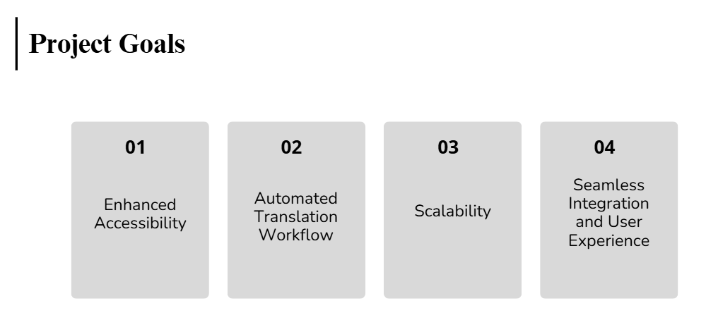

Slide 3
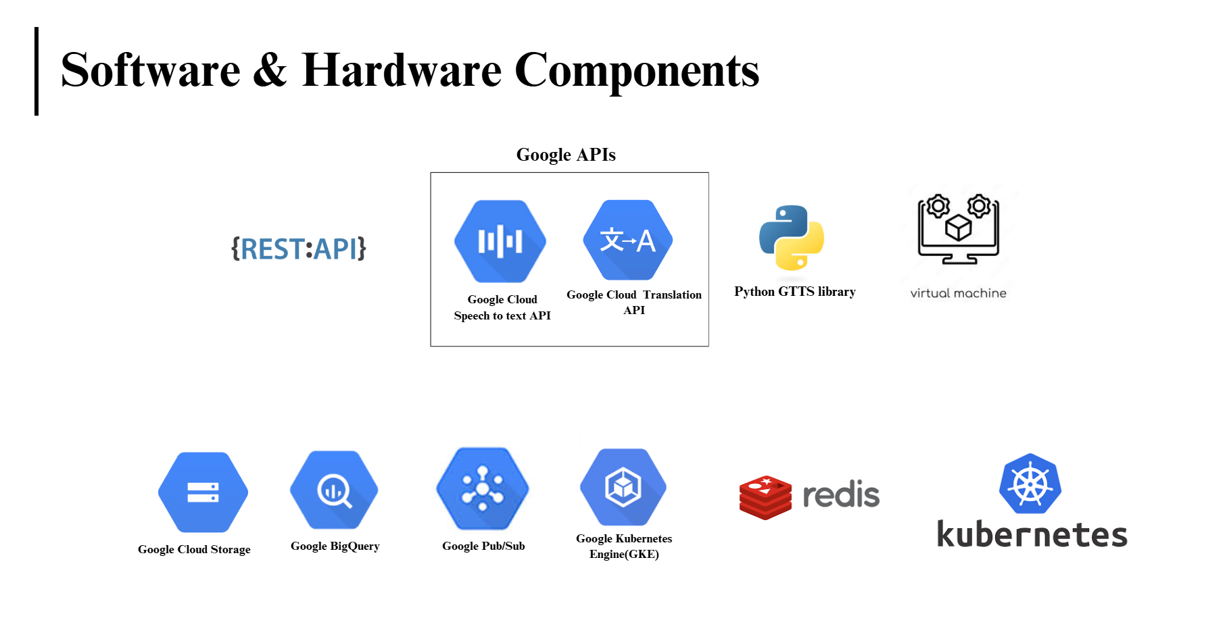

Slide 4

Architecture

Slide 5


Slide 6
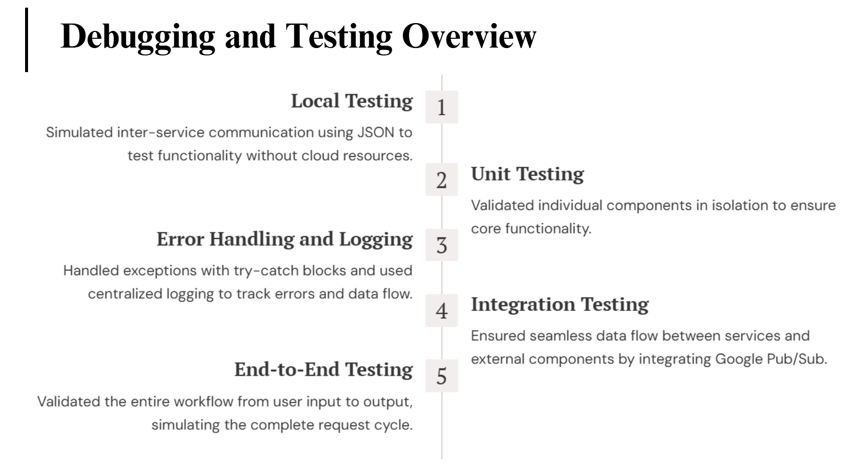



Slide 7
